Slide 1
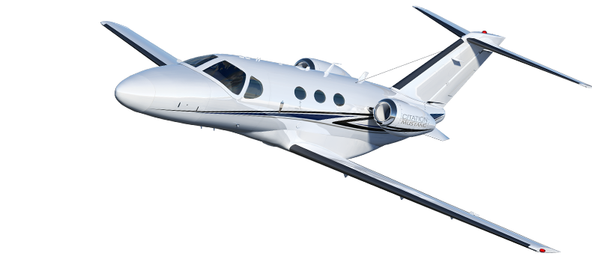

Mustang G1000 NXi Upgrade

Slide 2

CITATION MUSTANG G1000 NXi
FASTER
BRIGHTER
LIGHTER

Slide 3
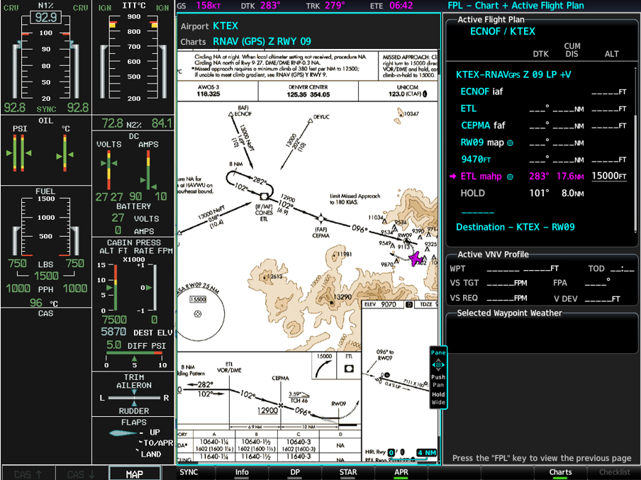
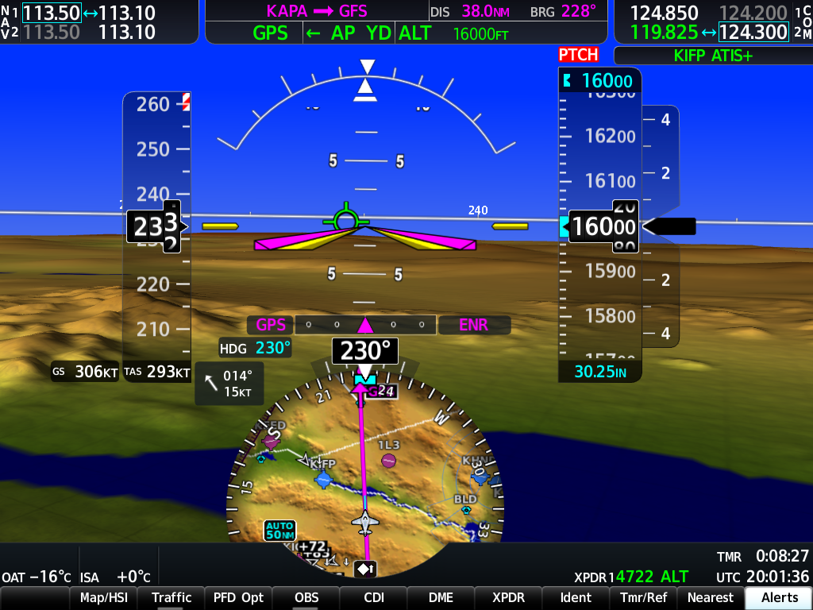
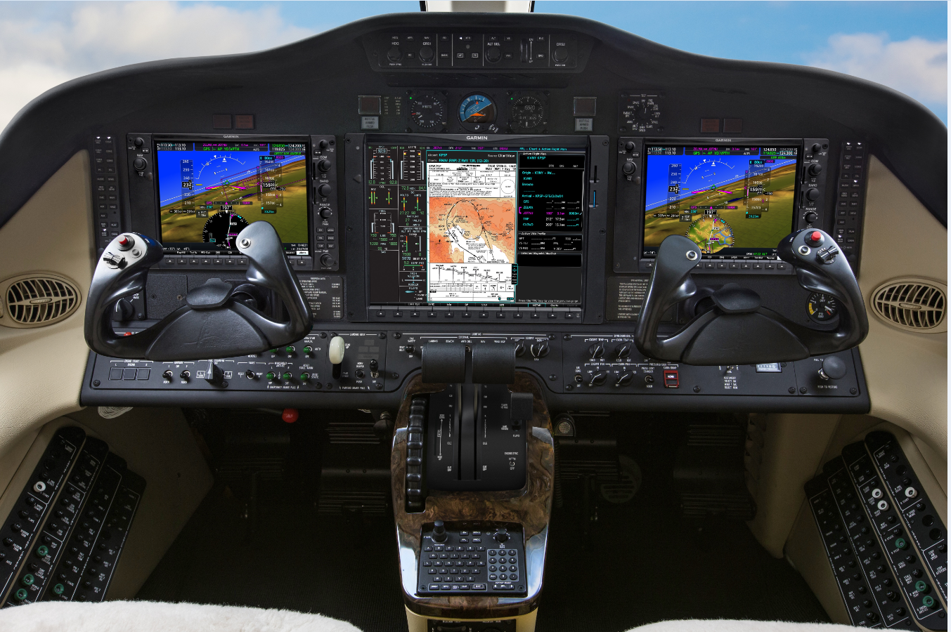
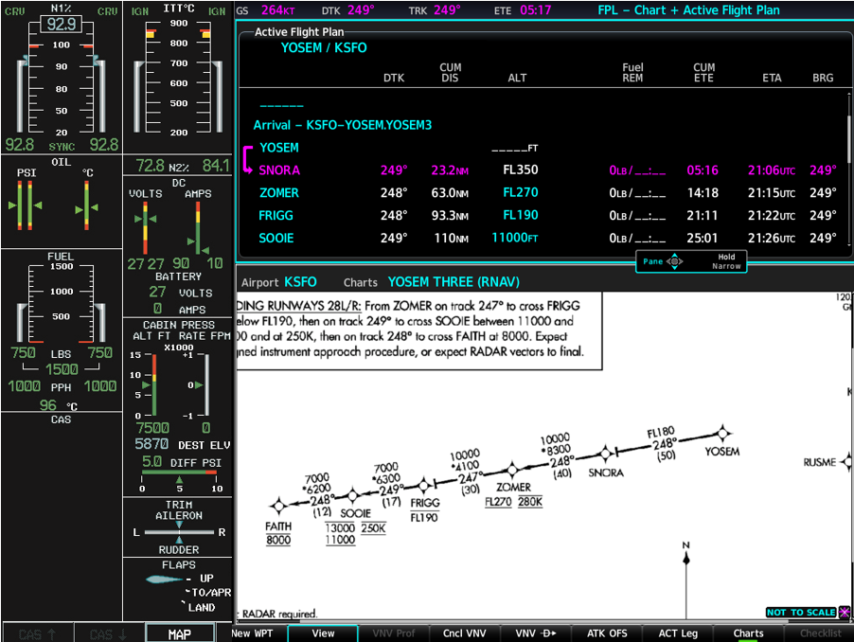
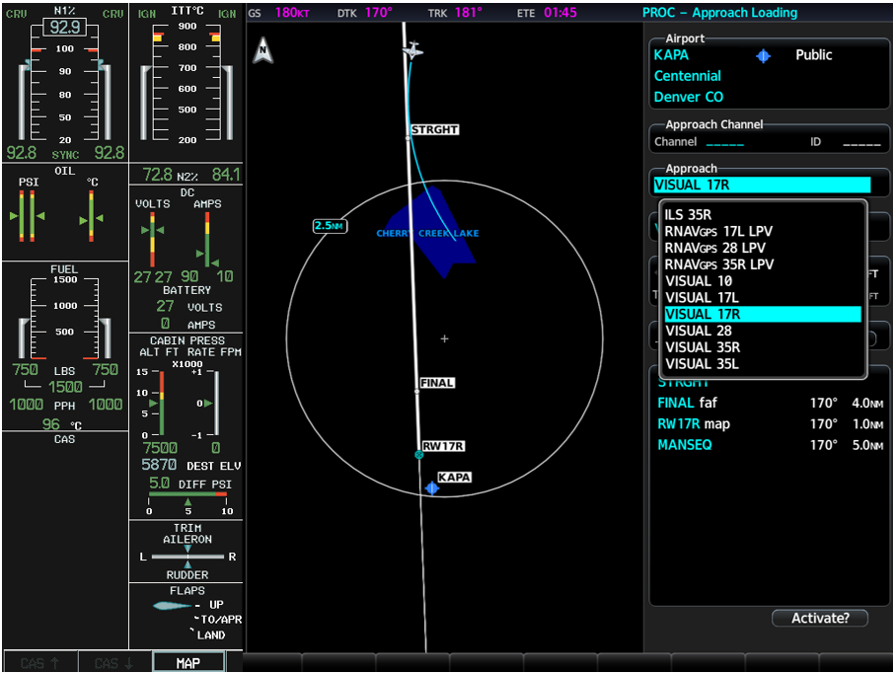
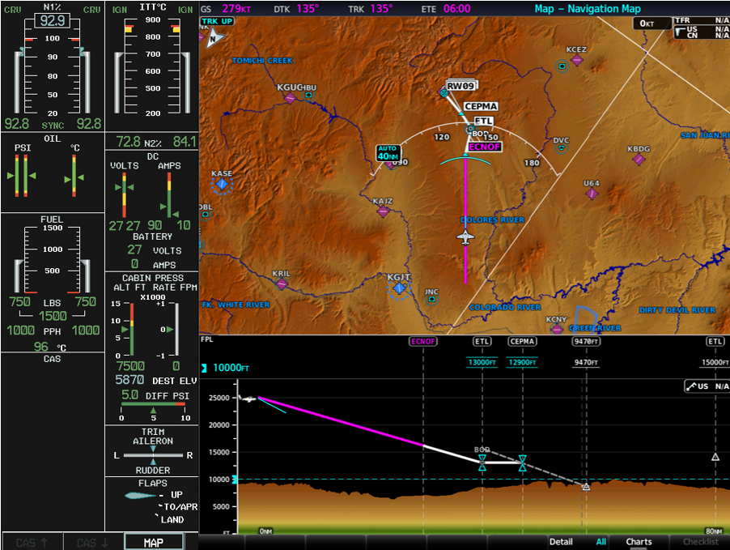
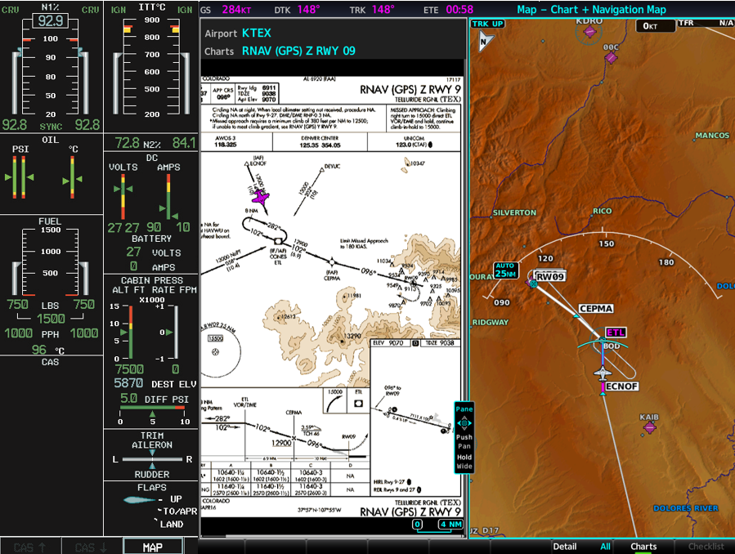
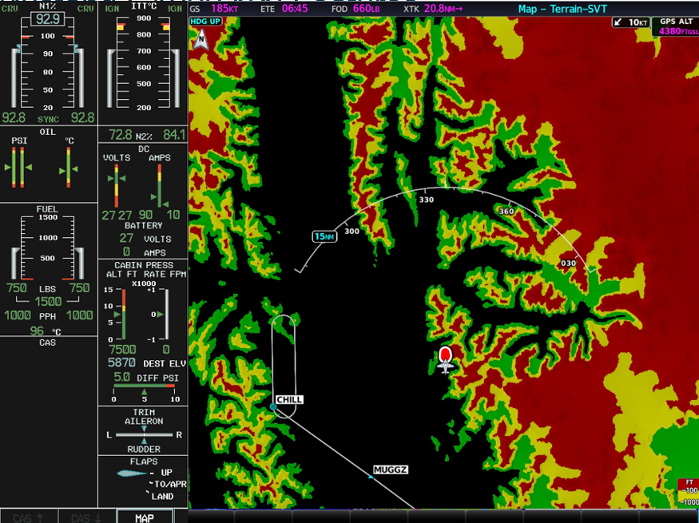
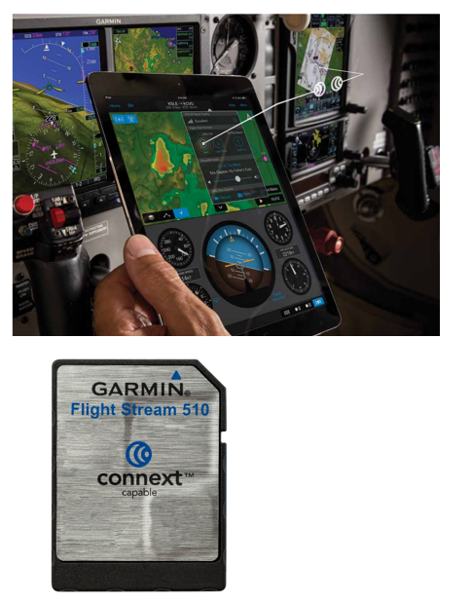
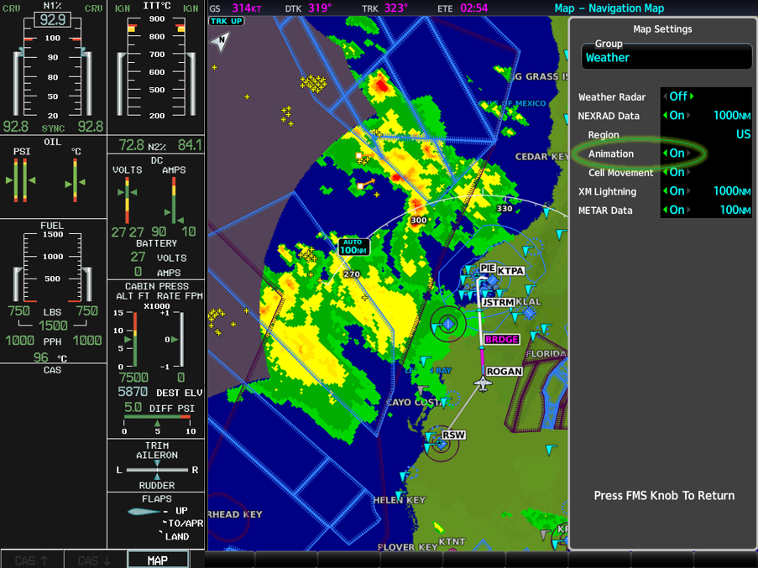
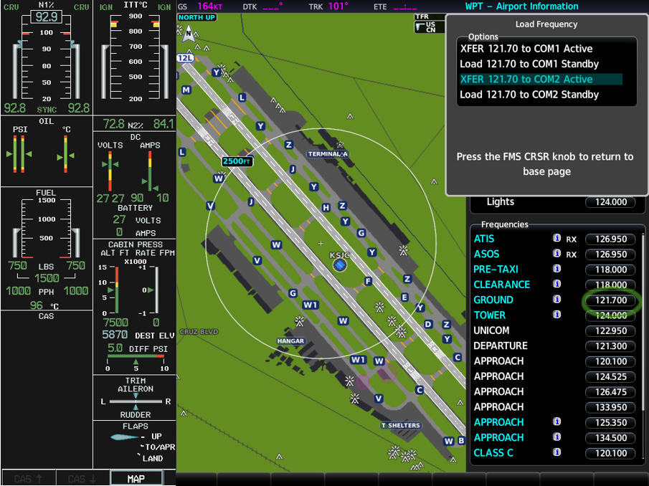
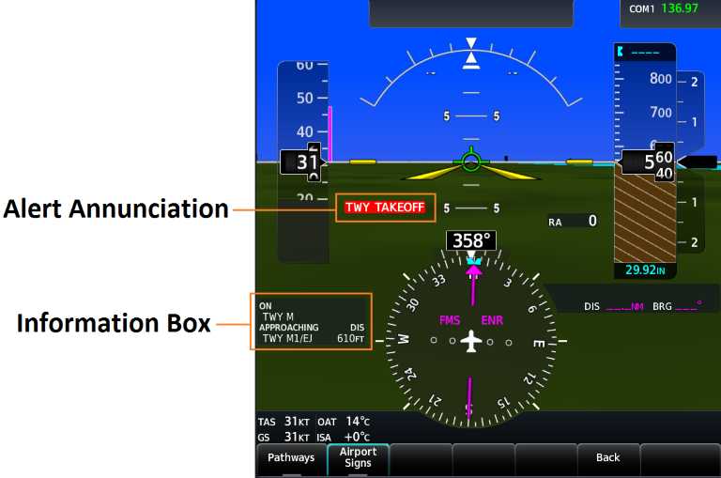
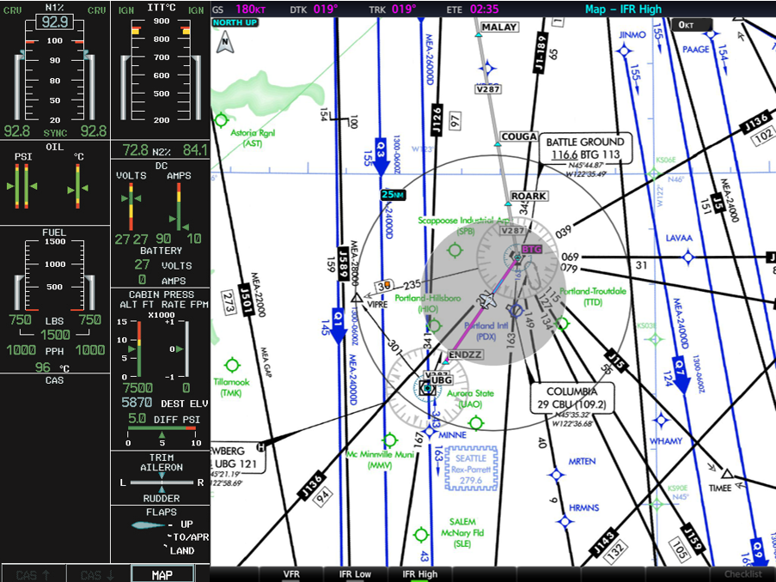
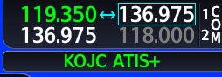
Citation Mustang G1000 NXi Features
HSI Map
Visual Approaches
IFR/VFR Charts
Vertical Profile Display
Surface Watch
Transition to Approach
Frequency Decoding
Frequency Loading
Flight Stream 510
Chart Split Screen (MAP)
Chart Split Screen (FPL)
Chart Split Screen (Wide)
Animated Nexrad
Three Color Terrain
Easy LRU Replacement

Slide 4
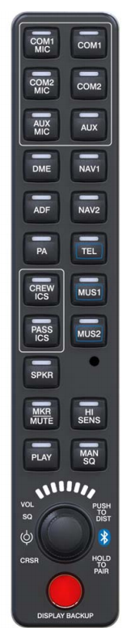
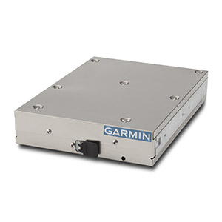
Optional Bluetooth Audio Panel & ADS-B IN/Out Transponder

Slide 5
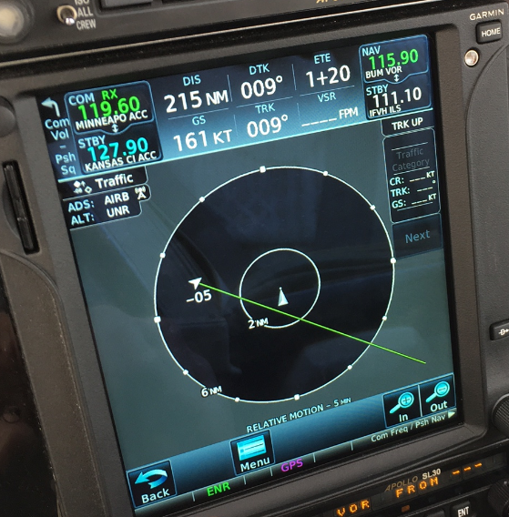
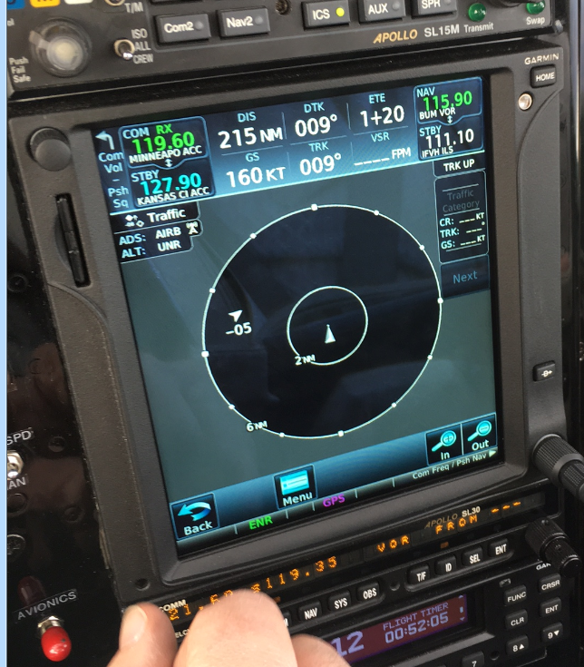
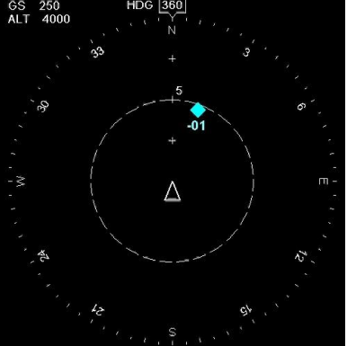
Target Trend/Relative Motion

Slide 6
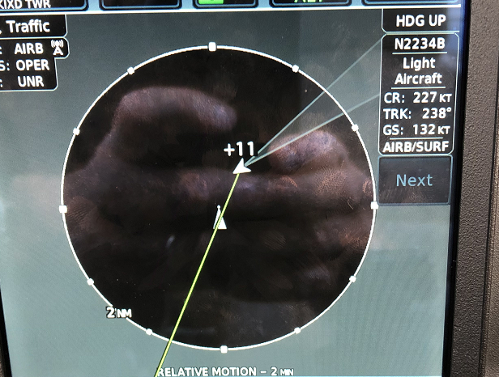
Target Trend/Relative Motion

Slide 7
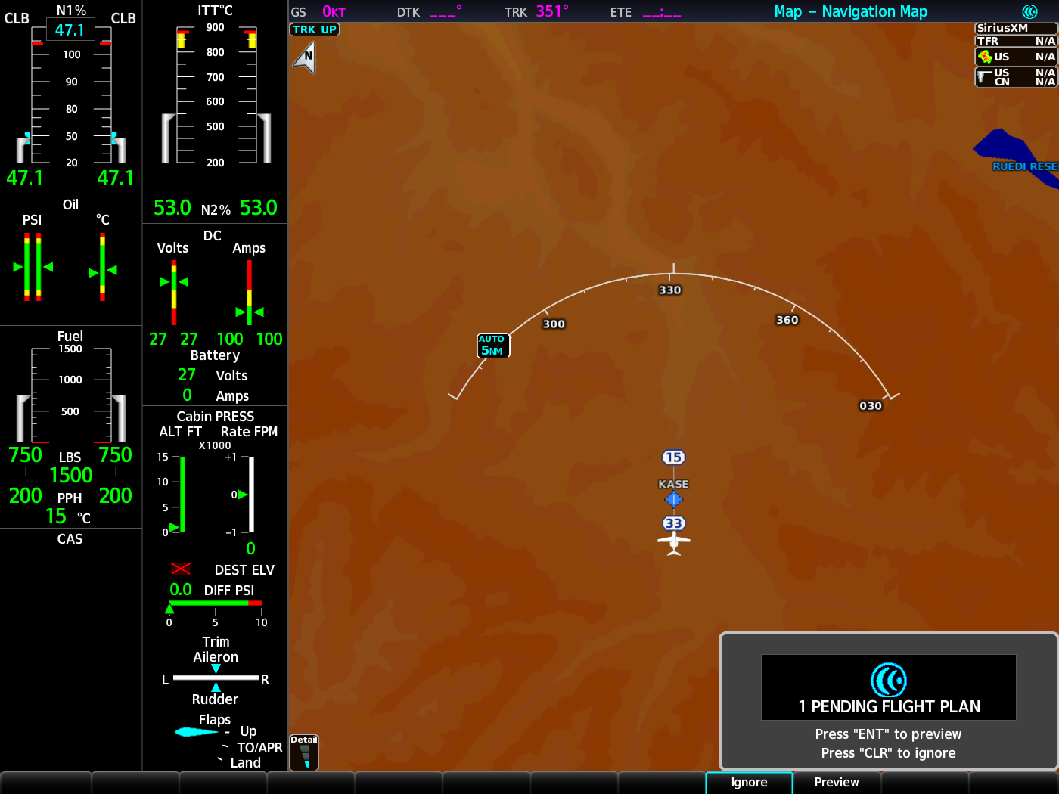


Computer-iPad-G1000 Flight Planning

Slide 8
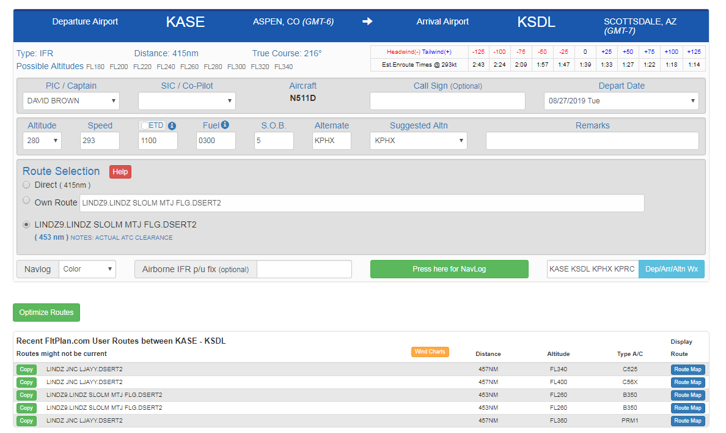
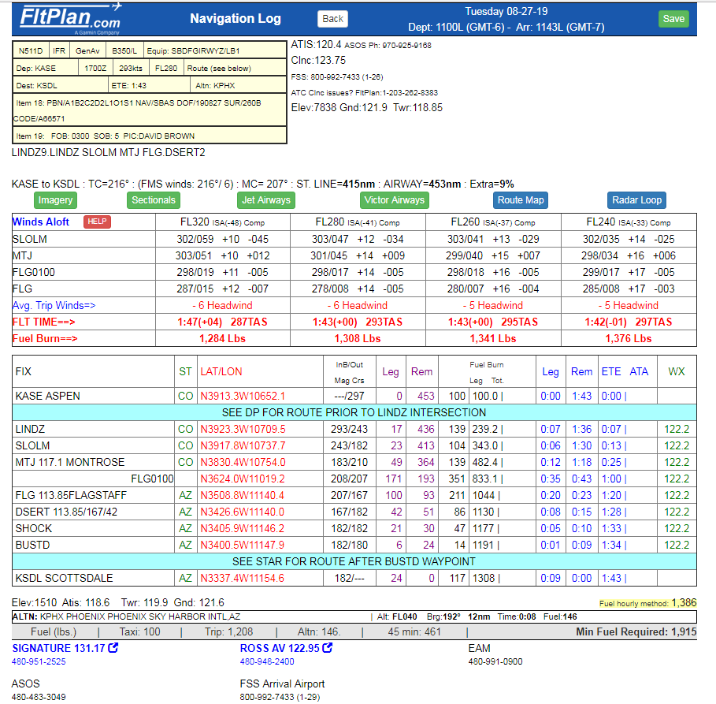
Building a Trip from Aspen To Scottsdale

Slide 9
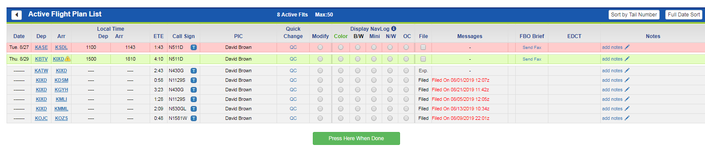
Building a Trip from Aspen To Scottsdale
Active Flight Plan List

Slide 10

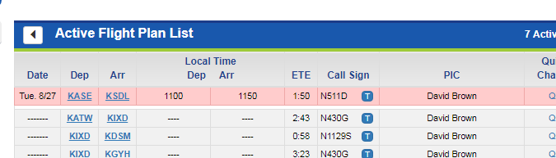
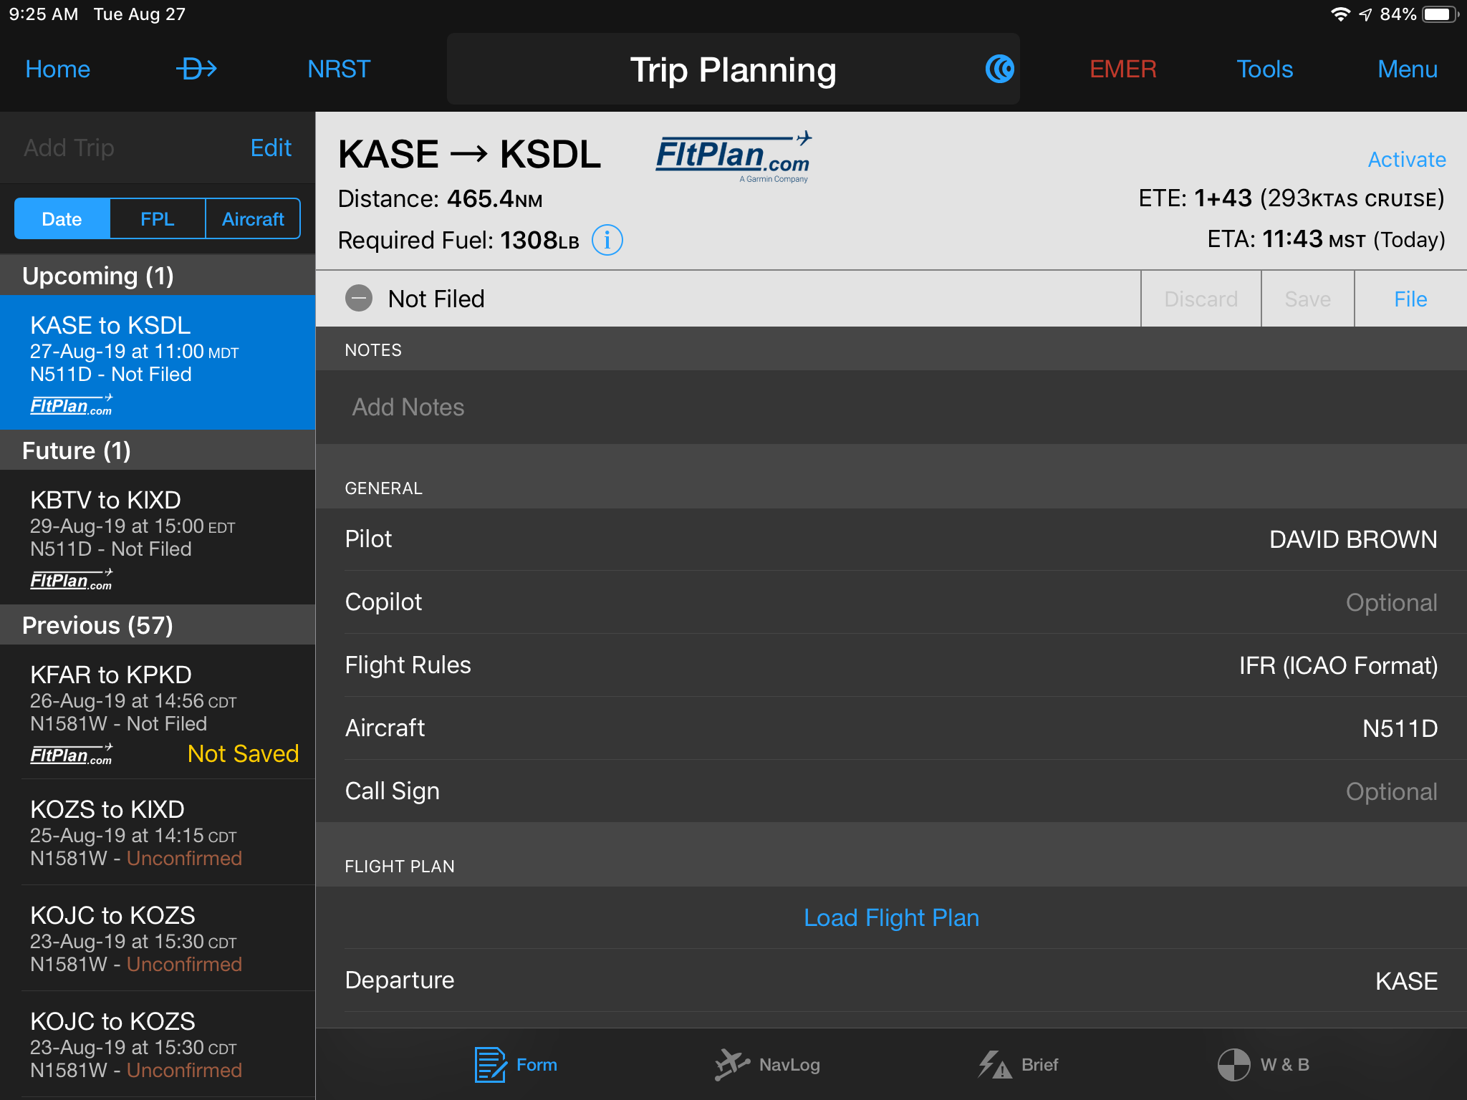
Syncs with

Slide 11

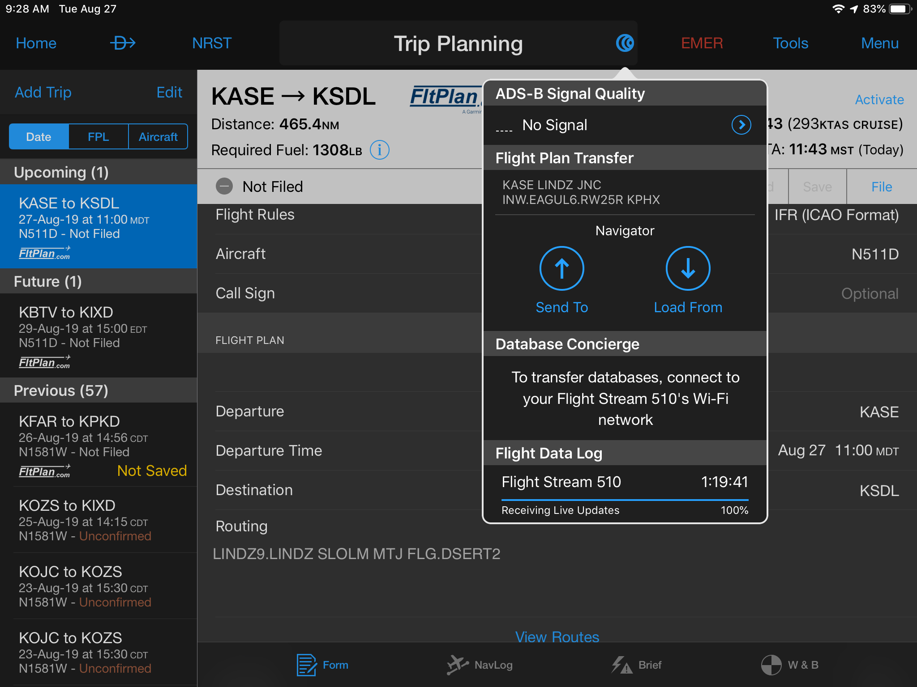
G1000 NXi

Slide 12
Hints and Tips
Menu is your Friend
Hold Transfer key for 121.5
Playback – for missed calls or frequency verification
Nrst ARTCC
North up above
One stop shopping… Airport info page
Target Trend (Relative motion) and how to set it up
Brief the Flight Plan
Shortcut for FPL,NRST, Recent
Shortcut to FL altitudes
Press any key and Load Airway appears..
VSD Winds Page
Leg to Leg – CUM Distance on FLT Plan

Slide 13
Simulator............

